Slide 1
Welcome to Manchester 500 Words 2023!
A Story-Writing Competition
for KS2 Children, sponsored by the University of Manchester

Slide 2
The Aim!
We know that there is HUGE writing talent within our Manchester schools!
So, we’d like all KS2 children to have a go at writing a story!
This is not a curriculum writing task. We are simply looking for one thing:
CREATIVITY!

Slide 3
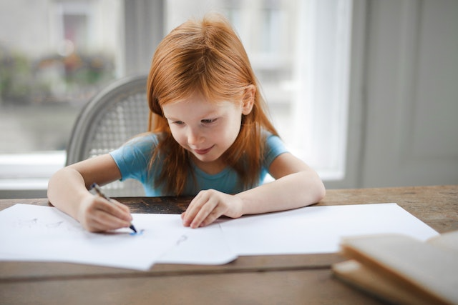
How it will work
Children:
Write a story! There are only 3 rules:
It has to be FICTION
It has to be typed
It has to be less than 500 words long
Teachers:
You will mark stories within your own schools and shortlist 2 entries per year group to go into the next round of judging.

Slide 4
What are we looking for? -The Criteria
Originality
Plot
Characterisation
Language
Enjoyment
Mark each feature out of 10

Slide 5
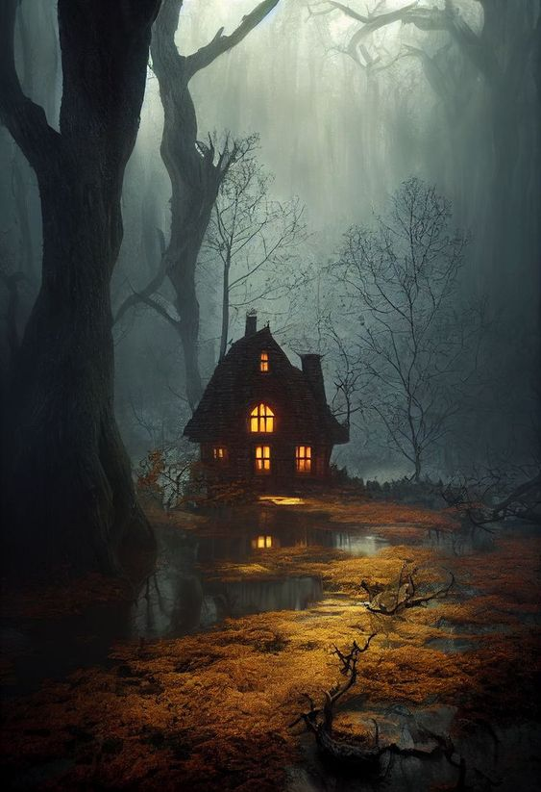
We will all start at the same point…
with a picture. We can all use this picture as a stimulus

Slide 6
The Judging
2. Second Round
First Round
This will be done by approximately 8 English experts from within the authories.
The Judges will not judge their own schools to ensure that it’s fair and impartial.
They will choose a the best submissions from Years 3, 4, 5 & 6 to proceed to the final. These will be the commended entries
This will be done by your teachers in school.
They will select two stories per year group to go through to the next round.
3. Final Round
A group of senior judges from Trafford and the University of Salford and Manchester Universities will select the runners up and an overall winner.

Slide 7
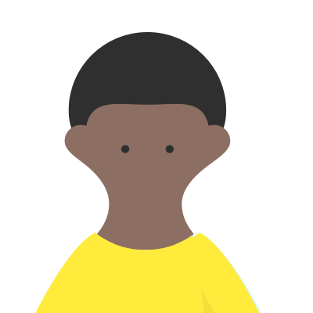
Prizes!
A kindle for the overall winners and £400 in funds for the School Library
All commended pieces to be included in an anthology
Book vouchers
Invitation to an Awards Ceremony, where the winning pieces will be read by a special guest and brought to life in a Drama performance

Slide 8
Next Steps
Shortlisted stories from each participating school need to be emailed to:
500words@wellfieldjunior.trafford.sch.uk
by Friday 16th June before 5pm
The shortlist for the second round will be announced on or after 30th June.
Winners will be announced early July.
Awards Ceremony- mid July

